Slide 1
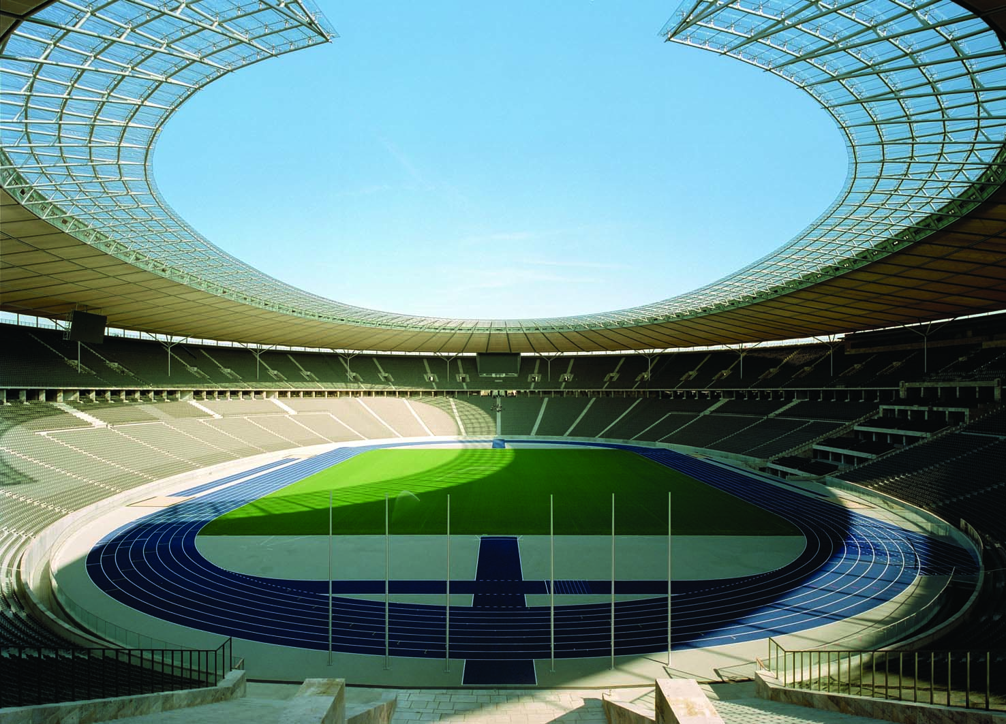
5
FIRM BEHAVIOUR AND THE
ORGANIZATION OF INDUSTRY

Slide 2
13
The Costs of Production

Slide 3

Figure 1 Economic versus Accountants
How an Economist
How an Accountant
Views a Firm
Views a Firm
Economic
profit
Accounting
profit
Implicit
Revenue
costs
Revenue
Total
opportunity
costs
Explicit
Explicit
costs
costs
Copyright © 2004 South-Western

Slide 4

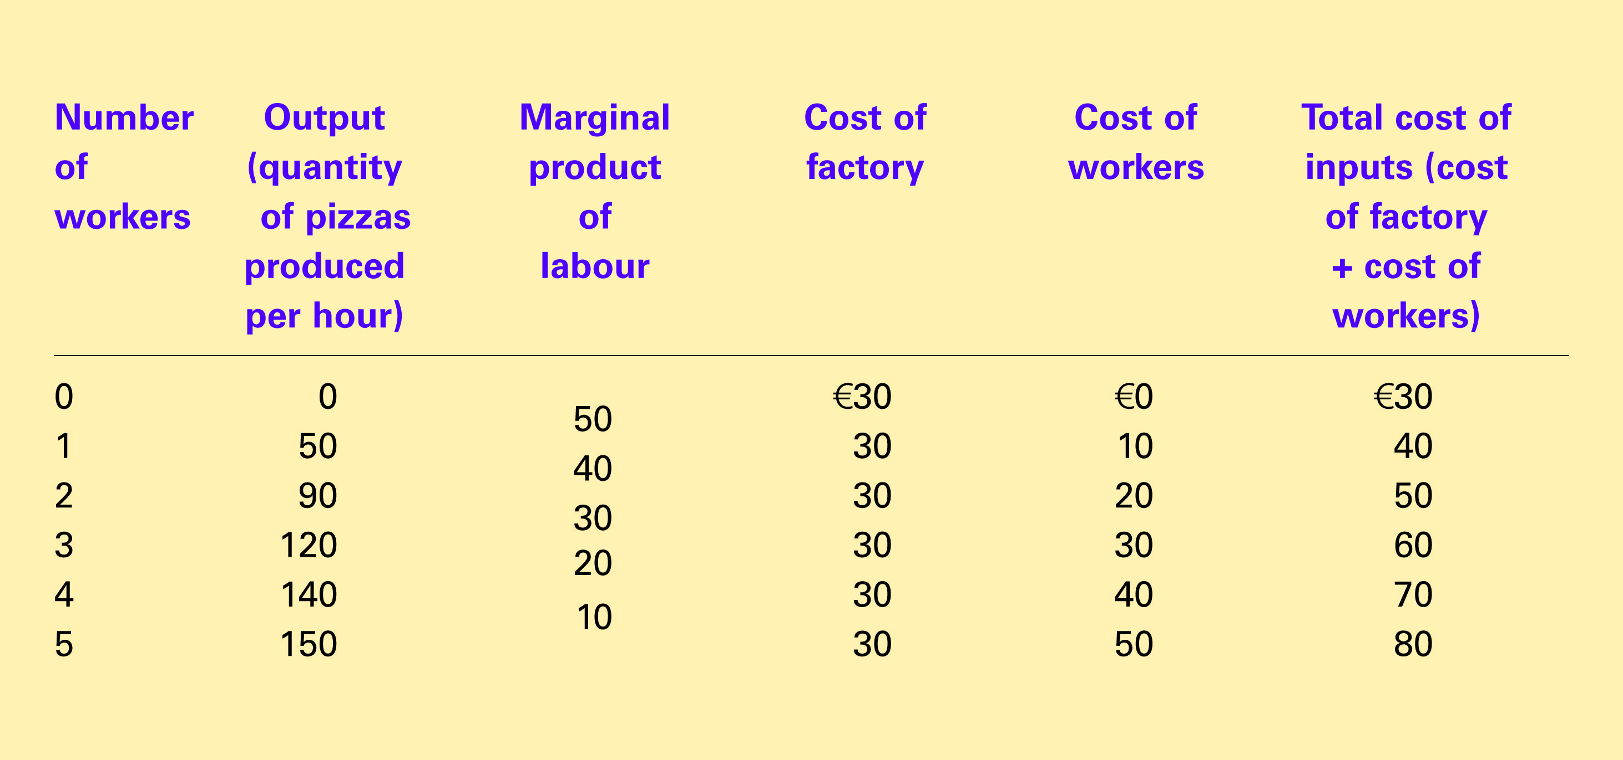
Table 1 A Production Function and Total Cost: Hungry Horace’s Pizza Factory
Copyright©2004 South-Western

Slide 5
Figure 2 Hungry Horace’s Production Function
Quantity of
Output
(pizzas
per hour)
150
Production function
140
130
120
110
100
90
80
70
60
50
40
30
20
10
0
1
2
3
4
5
Number of Workers Hired
Copyright © 2004 South-Western

Slide 6
Table 1 A Production Function and Total Cost: Hungry Helen’s Cookie Factory
Copyright©2004 South-Western

Slide 7
Figure 3 Hungry Horace’s Total Cost Curve
Total
Cost
€ 80
Total-cost
curve
70
60
50
40
30
20
10
0
10
20
30
40
50
60
70
80
90
100
110
120
130
140
150
Quantity
of Output
(pizzas per hour)
Copyright © 2004 South-Western

Slide 8
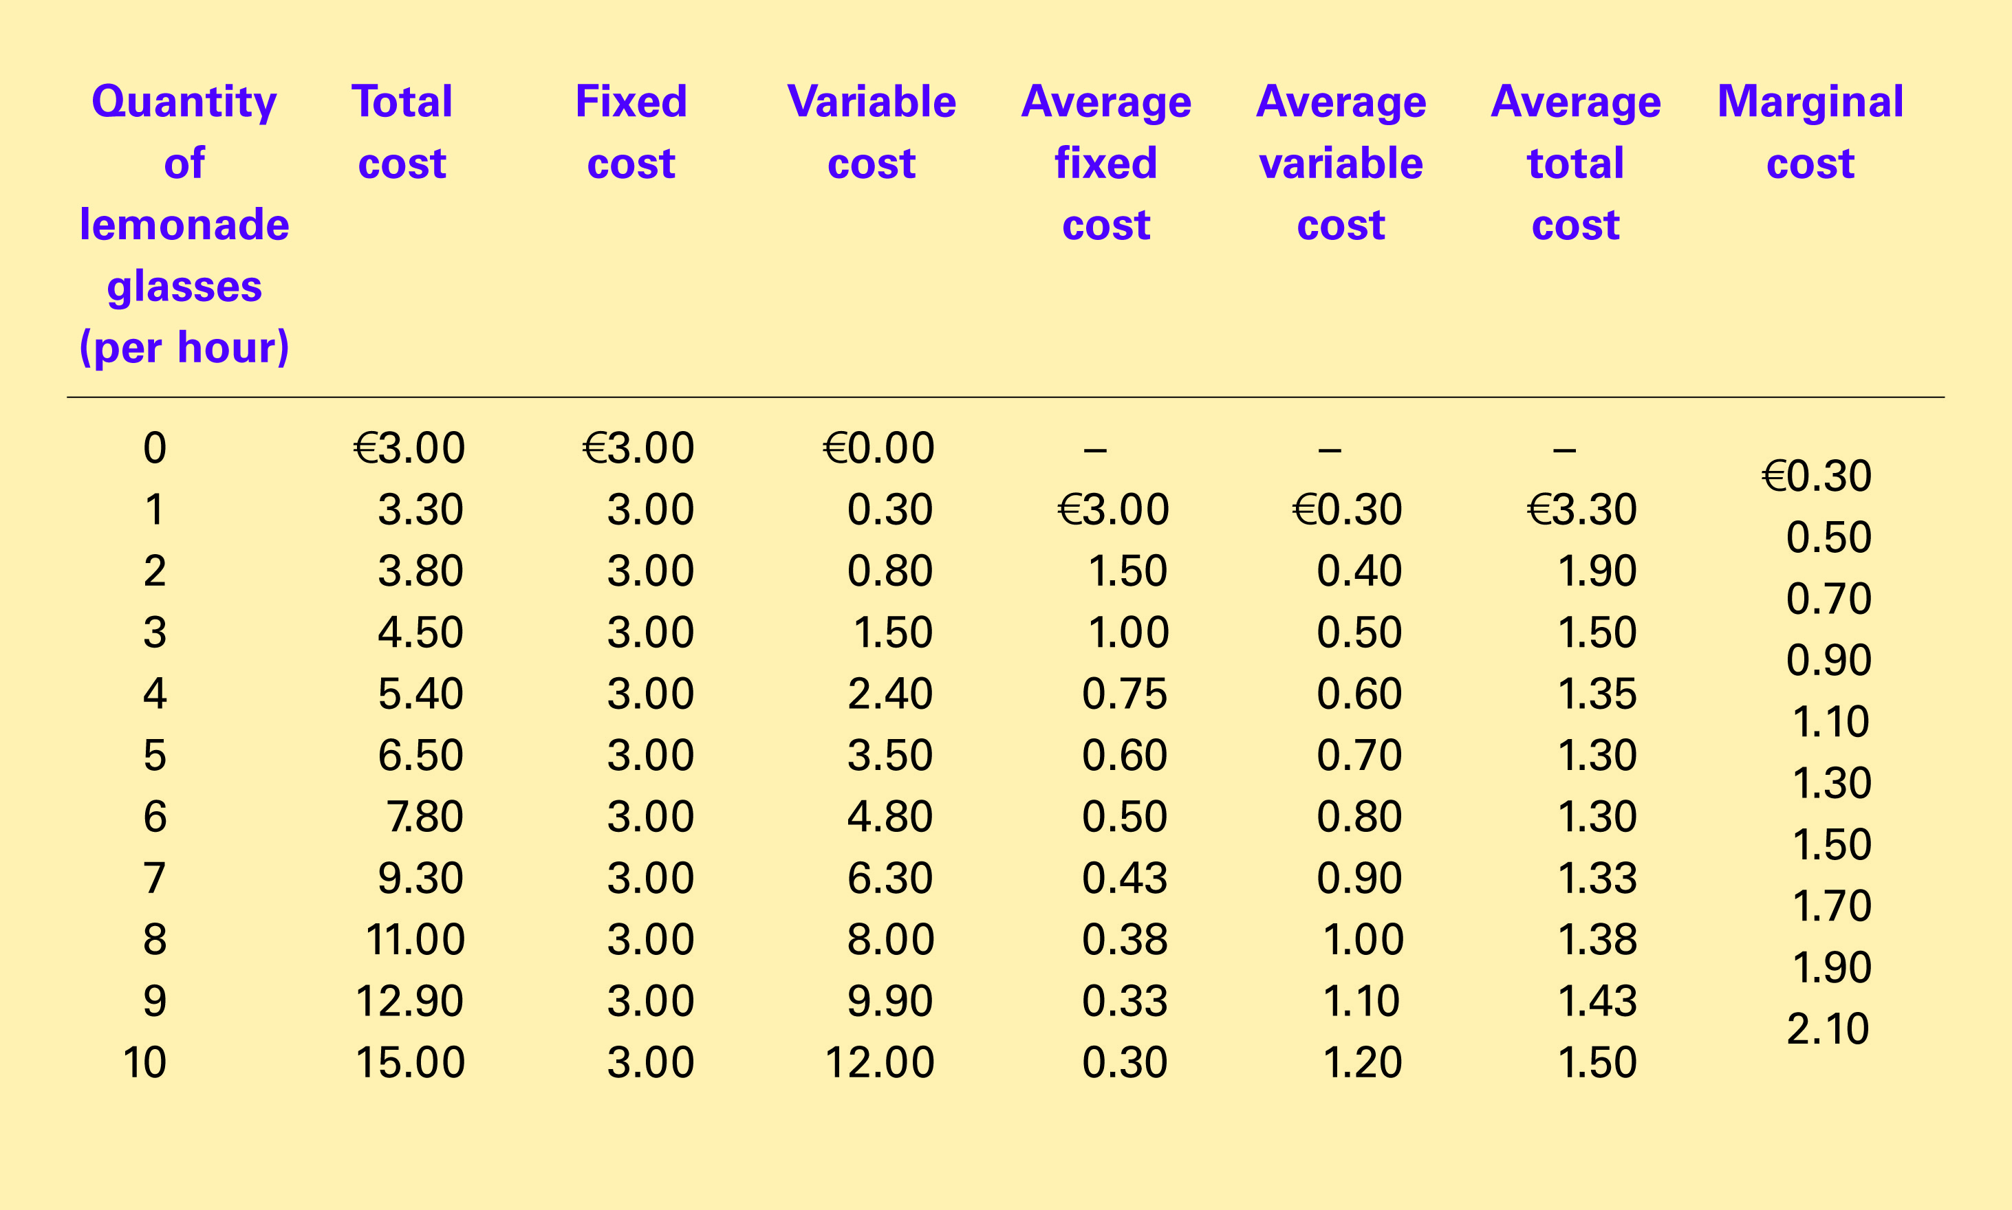
Table 2 The Various Measures of Cost: Thirsty Virgil’s Lemonade Stand
Copyright©2004 South-Western

Slide 9
Table 2 The Various Measures of Cost: Thirsty Thelma’s Lemonade Stand
Copyright©2004 South-Western

Slide 10
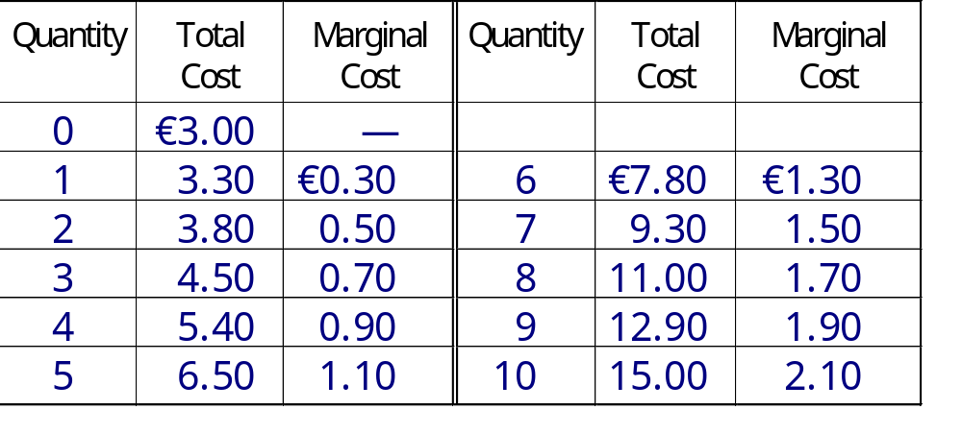
Marginal Cost
Thirsty Virgil’s Lemonade Stand

Slide 11
Figure 4 Thirsty Virgil’s Total Cost Curve
Total Cost
€15.00
Total-cost curve
14.00
13.00
12.00
11.00
10.00
9.00
8.00
7.00
6.00
5.00
4.00
3.00
2.00
1.00
0
1
2
3
4
5
6
7
8
9
10
Quantity
of Output
(glasses of lemonade per hour)
Copyright © 2004 South-Western

Slide 12
Figure 5 Thirsty Virgil’s Average Cost and Marginal Cost Curves
Costs
€ 3.50
3.25
3.00
2.75
2.50
2.25
MC
2.00
1.75
1.50
ATC
1.25
AVC
1.00
0.75
0.50
0.25
AFC
0
1
2
3
4
5
6
7
8
9
10
Quantity
of Output
(glasses of lemonade per hour)
Copyright © 2004 South-Western

Slide 13
Figure 5 Thirsty Virgil’s Average-Cost and Marginal-Cost Curves
Costs
€ 3.50
3.25
3.00
2.75
2.50
2.25
MC
2.00
1.75
1.50
1.25
1.00
0.75
0.50
0.25
0
1
2
3
4
5
6
7
8
9
10
Quantity
of Output
(glasses of lemonade per hour)
Copyright © 2004 South-Western

Slide 14
Figure 5 Thirsty Virgil’s Average Cost and Marginal Cost Curves
Costs
€ 3.50
3.25
3.00
2.75
2.50
2.25
2.00
1.75
1.50
ATC
1.25
1.00
0.75
0.50
0.25
0
1
2
3
4
5
6
7
8
9
10
Quantity
of Output
(glasses of lemonade per hour)
Copyright © 2004 South-Western

Slide 15
Figure 5 Thirsty Virgil’s Average Cost and Marginal Cost Curves
Costs
€ 3.50
3.25
3.00
2.75
2.50
2.25
MC
2.00
1.75
1.50
ATC
1.25
1.00
0.75
0.50
0.25
0
1
2
3
4
5
6
7
8
9
10
Quantity
of Output
(glasses of lemonade per hour)
Copyright © 2004 South-Western

Slide 16
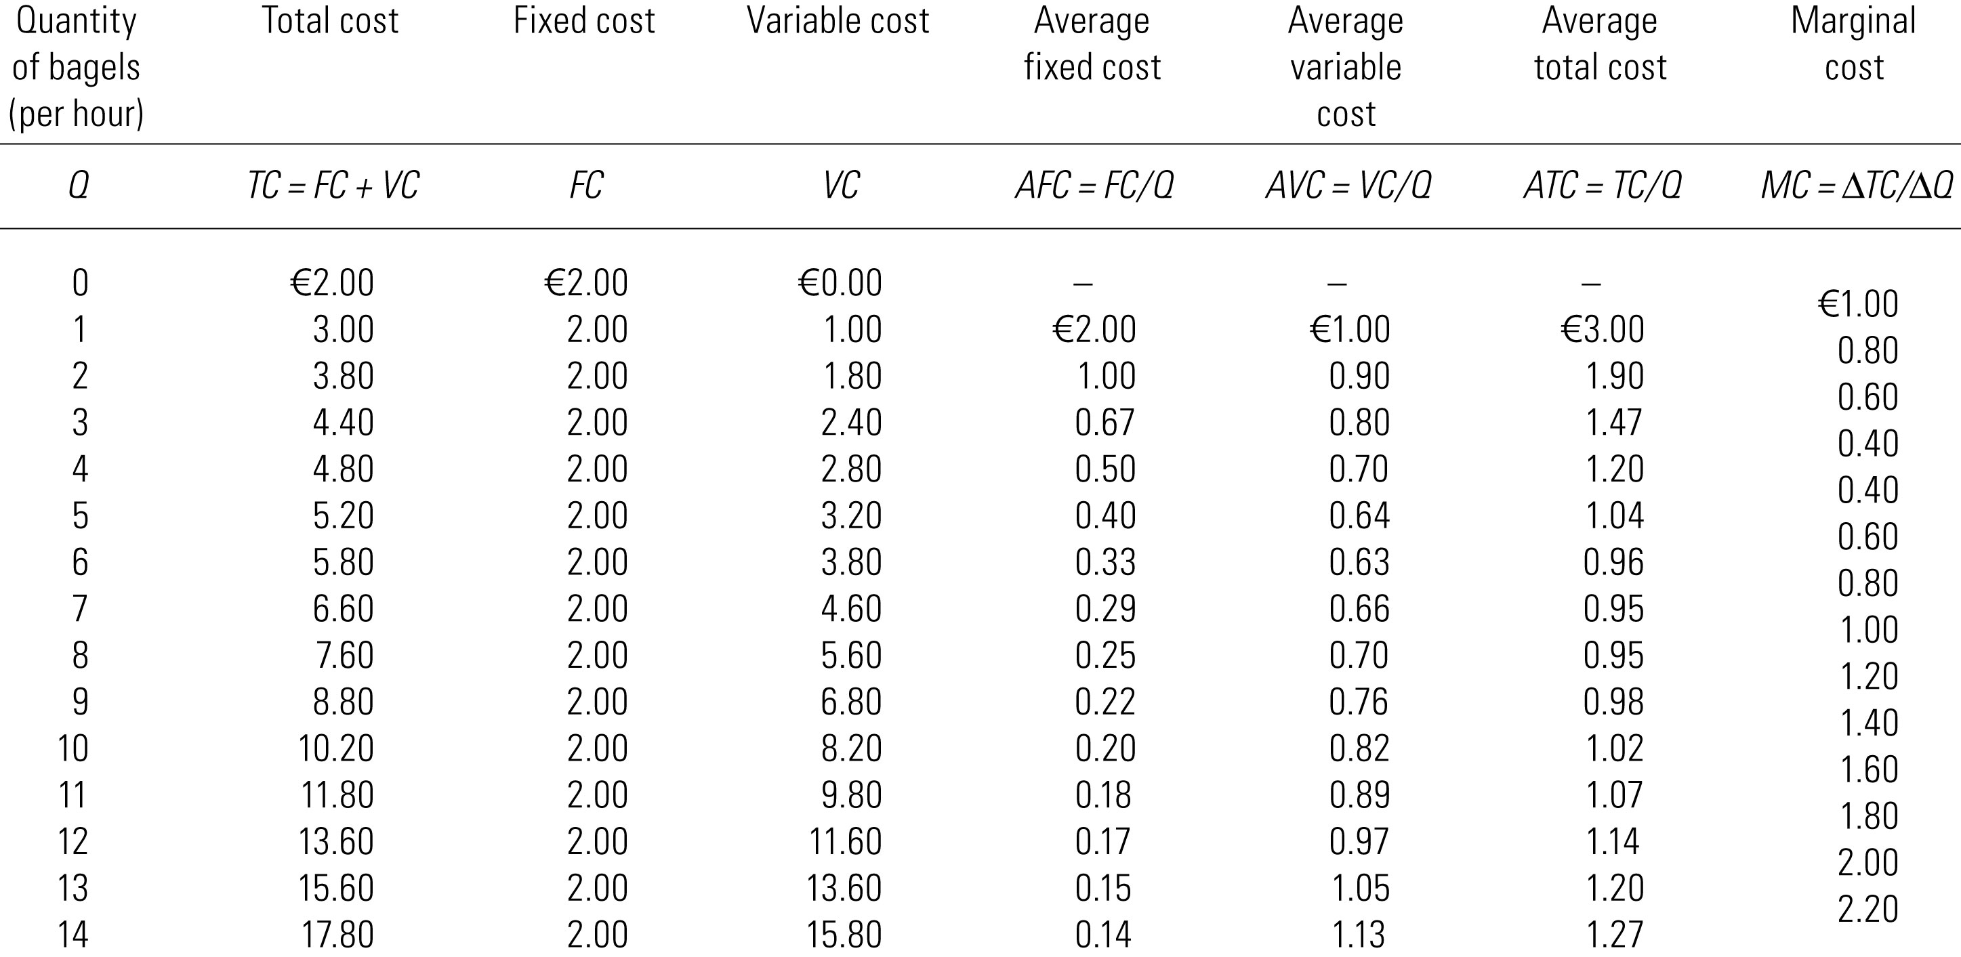
Big Bob’s Cost Curves

Slide 17
Figure 6 Big Bob’s Cost Curves
(a) Total Cost Curve
Total
Cost
€18.00
TC
16.00
14.00
12.00
10.00
8.00
6.00
4.00
2.00
0
2
4
6
8
10
12
14
Quantity of Output (bagels per hour)
Copyright © 2004 South-Western

Slide 18
Figure 6 Big Bob’s Cost Curves
(b) Marginal and Average Cost Curves
Costs
€ 3.00
2.50
MC
2.00
1.50
ATC
1.00
AVC
0.50
AFC
0
2
4
6
8
10
12
14
Quantity of Output (bagels per hour)
Copyright © 2004 South-Western

Slide 19
Figure 7 Average Total Cost in the Short and Long Run
Average
Total
ATC
in short
ATC
in short
ATC
in short
Cost
run with
run with
run with
small factory
medium factory
large factory
€ 12,000
ATC
in long run
0
1,200
Quantity of
Cars per Day
Copyright © 2004 South-Western

Slide 20
Figure 7 Average Total Cost in the Short and Long Run
Average
Total
ATC
in short
ATC
in short
ATC
in short
Cost
run with
run with
run with
small factory
medium factory
large factory
ATC
in long run
€ 12,000
10,000
Economies
Constant
of
returns to
scale
scale
Diseconomies
of
scale
0
1,000
1,200
Quantity of
Cars per Day
Copyright © 2004 South-Western

